Slide 1
SLE Analysis

Slide 2
Sample Sizes
For ER, only included entanglements on 4 HO sites
Entanglement Rates: 611 Entanglements
ER California: 178
ER Steller: 433
For MA, included all entanglements with a photo quality >1, from any HO
Material Analysis: 502
MA California: 145
MA Steller: 357

Slide 3
Entanglement Rates Model Comparison AIC
AIC Table
Model Parameters | AICc
Species | -5265.625
Species * Year | -5264.645
Year | -5264.138
Month | -5262.519
Species * Month | -5262.377
Complex | -5260.756
Year * Month | -5260.229
Species * Complex | -5259.122
Species * Year * Month | -5258.481
Complex * Month | -5253.356
Species * Complex * Year * Month | -5221.612
Rates used as input to the model were calculated from the # of entangled individuals/total count in each sighting, which was then directly put into the different model structures.
Due to the insignificant effect of complex on entanglement rate, complex was dropped from the stratifications used to calculate final entanglement rates, but averages were stratified by month and year and separated by species

Slide 4
Entanglement Rates by Species
Steller Entanglement Rate: 0.4321%
California Entanglement Rate: 2.8605%
Calculated with stratification: pooled # entanglements/pooled total counts per day -> averaged over month-years -> averaged over years -> averaged overall

Slide 5
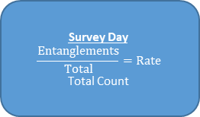
Tatoosh
# Entanglements
Total Count
Monthly
Average Rate
Averaged
Total
Average Rate
East Bodelteh
# Entanglements
Total Count
Survey Day
$$\frac{Entanglements}{Total}=Rate$$
Total Count
Survey Month
Average Rate
Average Count
Pooled
Averaged
Averaged
Carroll
# Entanglements
Total Count
Yearly
Average Rate
Average Count
ln(N_{t}+1/N_{t})
Yearly
Change Rate
Averaged
Total
Average Change Rate
Sea Lion Rock
# Entanglements
Total Count

Slide 6
T-test showed significant difference between entanglement rates by species (p=0.04)
t-Test: Two-Sample Assuming Unequal Variances
 | Steller | California
Mean | 0.004321 | 0.028605
Variance | 3.91E-06 | 0.000936
Observations | 9 | 9
Hypothesized Mean Difference | 0
df | 8
t Stat | -2.37613
P(T<=t) one-tail | 0.022408
t Critical one-tail | 1.859548
P(T<=t) two-tail | 0.044815
t Critical two-tail | 2.306004
Two tail because the question is if they are different

Slide 7
One-way ANOVA showed annual differences in entanglement rates for Steller (p=2.68E-45)
Anova: Single Factor
SUMMARY
Groups | Count | Sum | Average | Variance
Year | 9 | 18126 | 2014 | 7.5
Rate | 9 | 0.03889 | 0.004321 | 3.91E-06
ANOVA
Source of Variation | SS | df | MS | F | P-value | F crit
Between Groups | 18252804 | 1 | 18252804 | 4867412 | 2.68E-45 | 4.493998
Within Groups | 60.00003 | 16 | 3.750002
Total | 18252864 | 17

Slide 8
Post-hoc showed…

Slide 9
One-way ANOVA showed annual differences in entanglement rates for California (p=2.68E-45)
Anova: Single Factor
SUMMARY
Groups | Count | Sum | Average | Variance
Year | 9 | 18126 | 2014 | 7.5
Rate | 9 | 0.257445 | 0.028605 | 0.000936
ANOVA
Source of Variation | SS | df | MS | F | P-value | F crit
Between Groups | 18252364 | 1 | 18252364 | 4866689 | 2.68E-45 | 4.493998
Within Groups | 60.00749 | 16 | 3.750468
Total | 18252424 | 17

Slide 10
Post-hoc showed…

Slide 11
Material Analysis

Slide 12
MA by month
Majority packing bands, Flashers June-September.

Slide 13
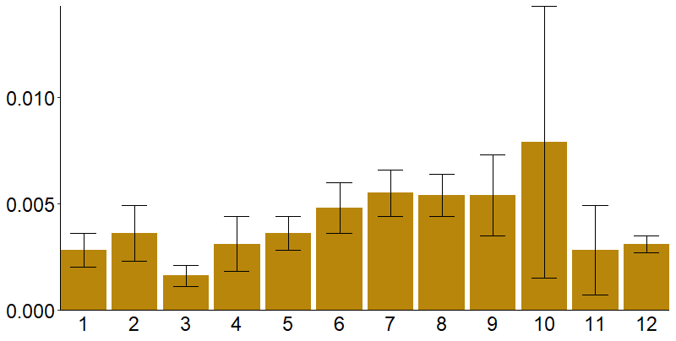
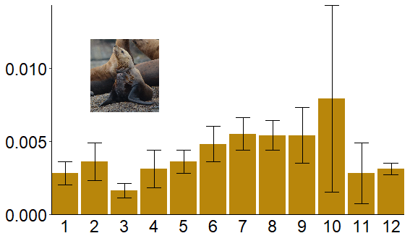
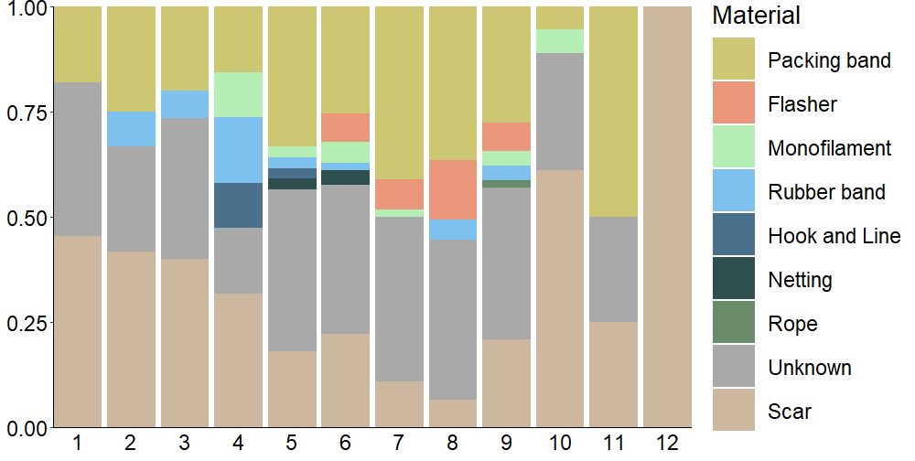
Average Entanglement Rate
Proportion of Entanglements
Month

Slide 14
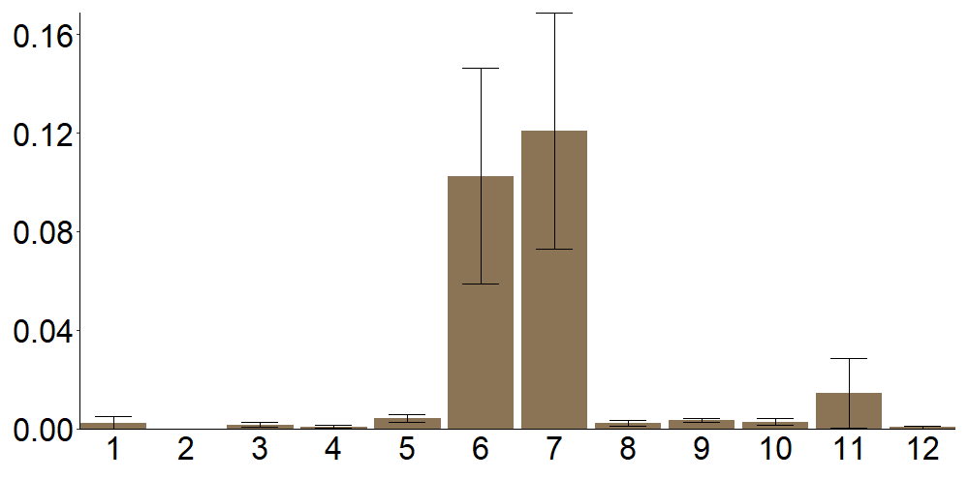

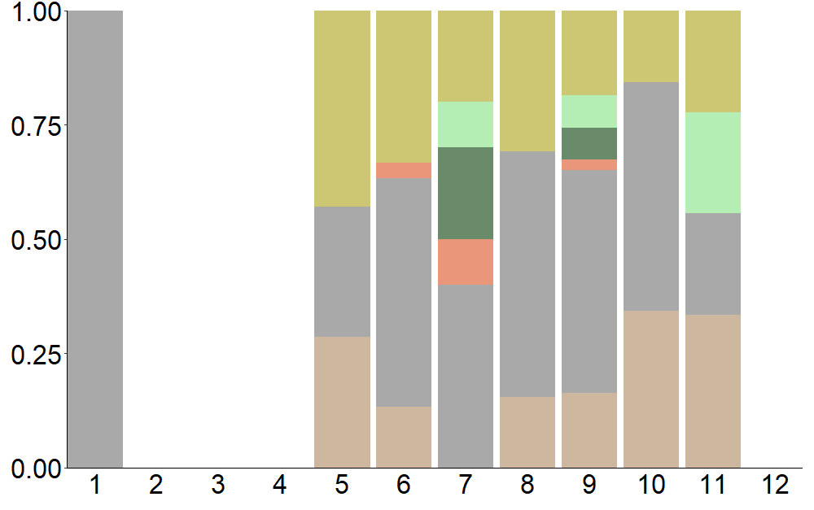
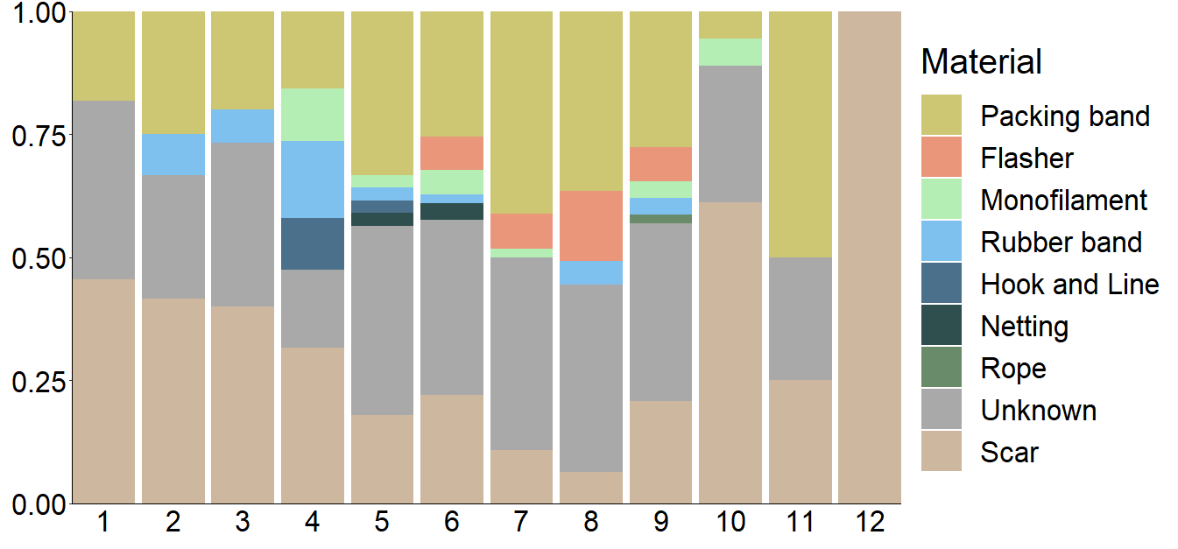
California
Steller
Average Entanglement Rate
Proportion of Entanglements
Month
Month

Slide 15
California
Steller
Average Entanglement Rate
Proportion of Entanglements
Month
Month

Slide 16
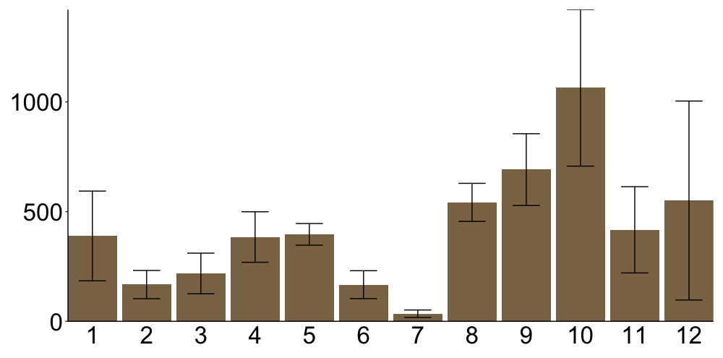
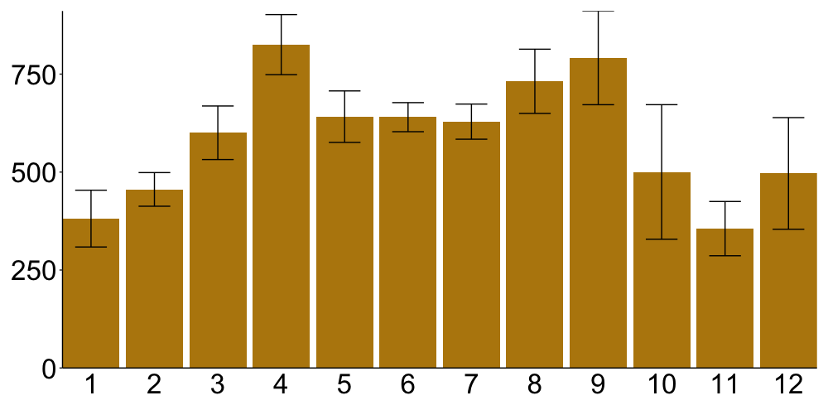
California
Steller
Average Count
Average Entanglement Rate
n = 145
n = 357
Proportion of Entanglements
Month
Month

Slide 17
Average Count
Average Entanglement Rate
Month

Slide 18
MA by year, all

Slide 20
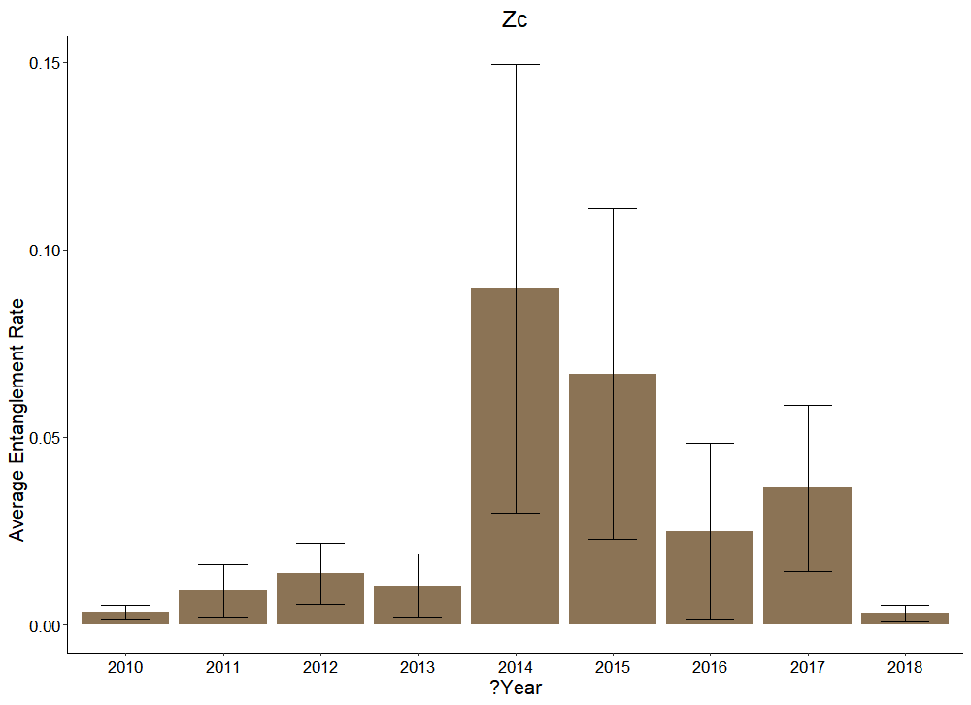
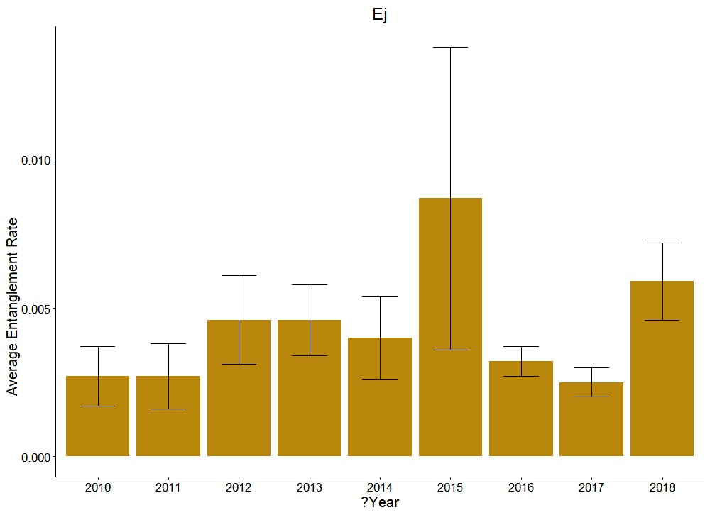
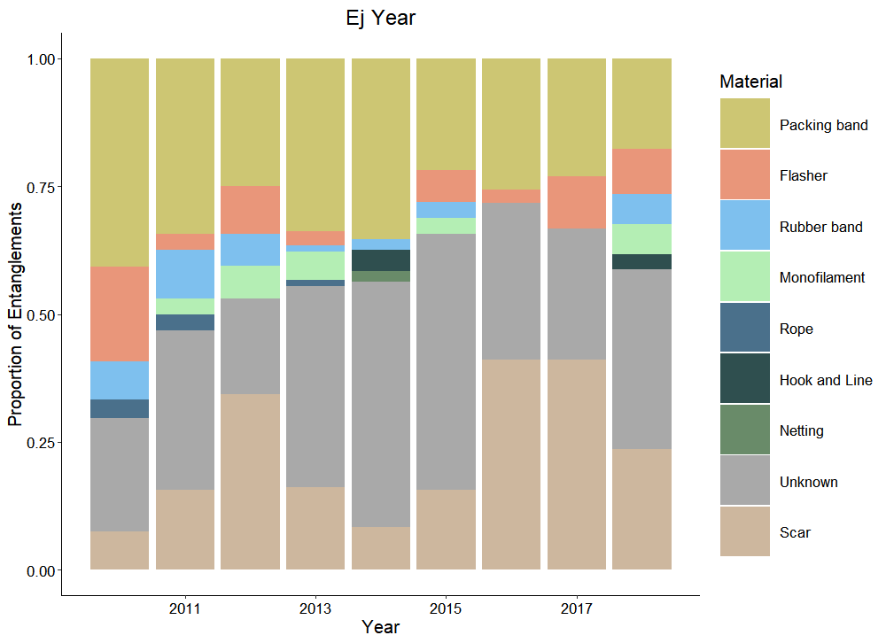
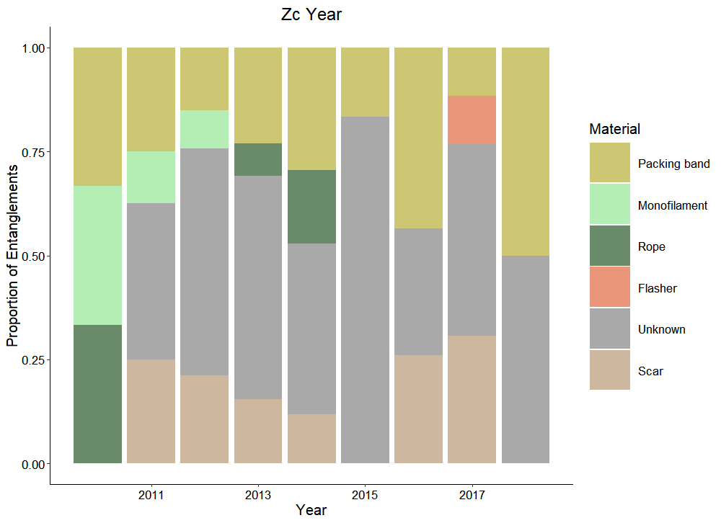

Slide 21
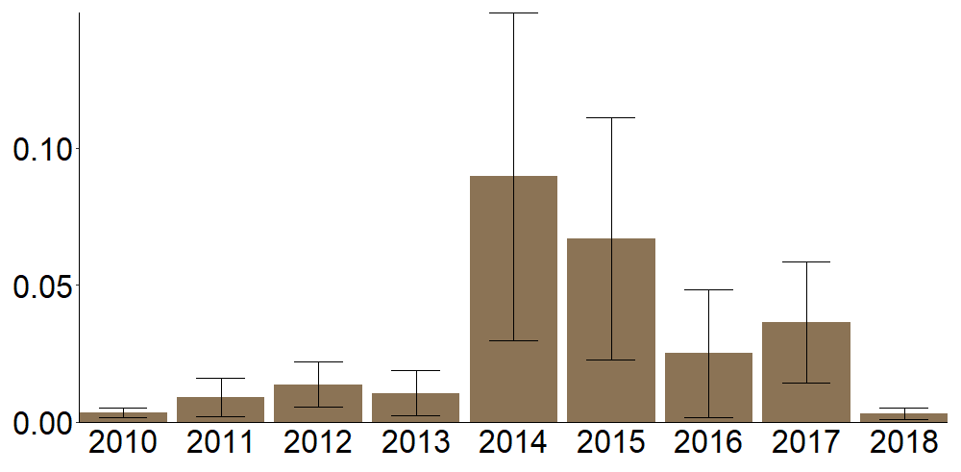
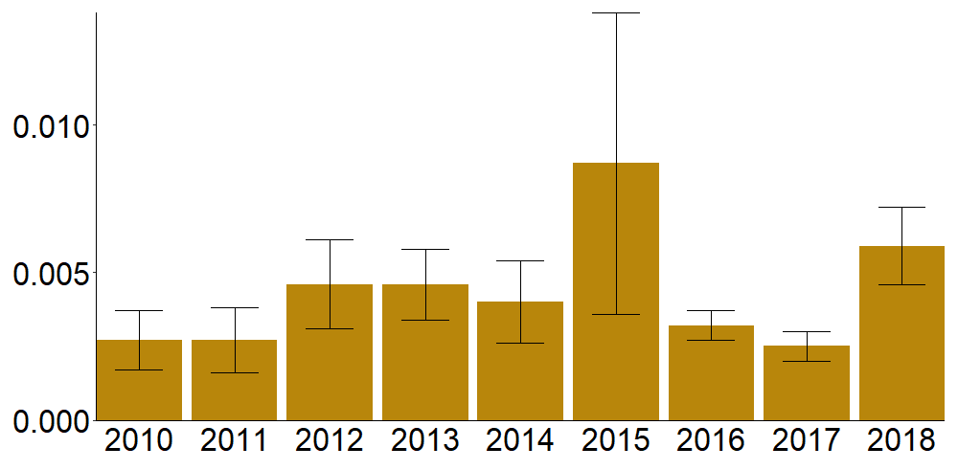
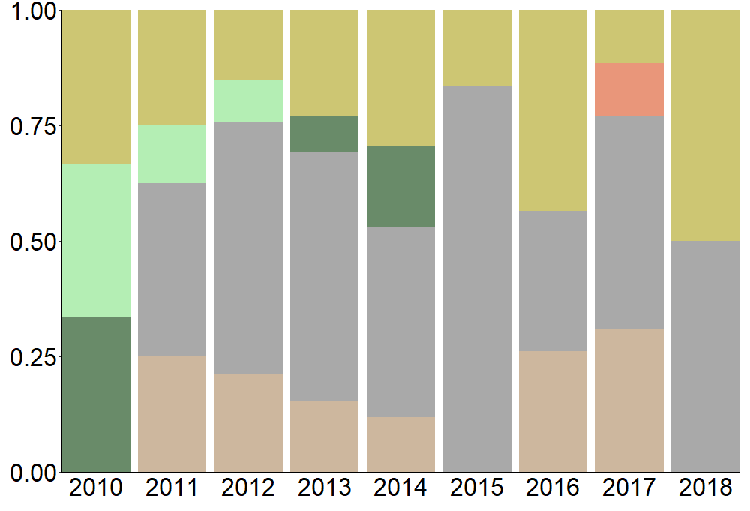
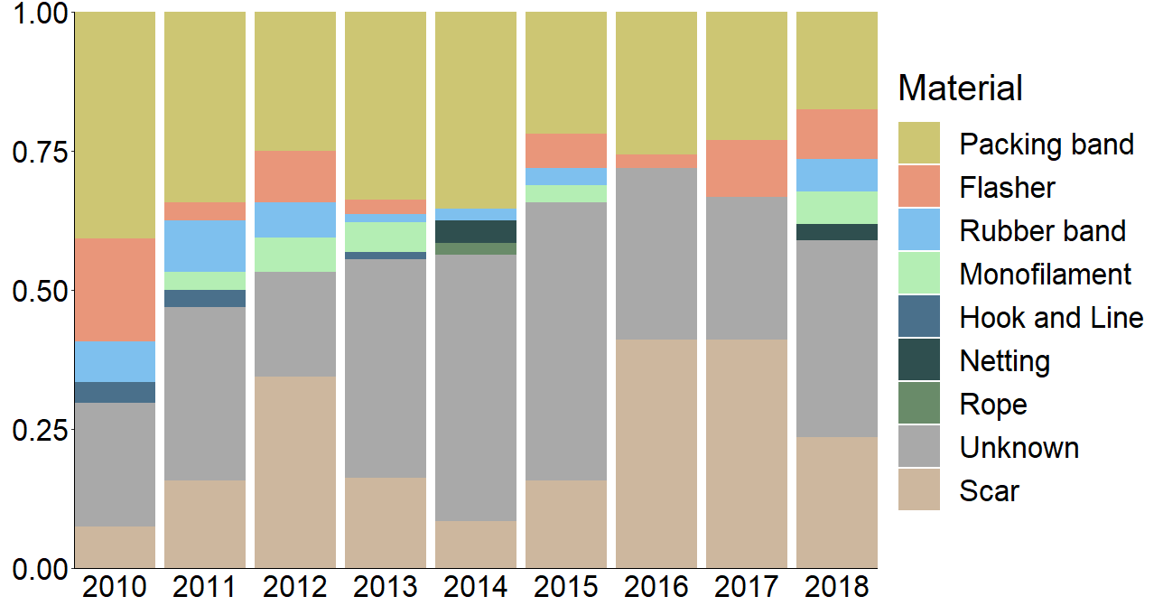
n = 433
California
Steller
Average Entanglement Rate
n = 145
n = 357
Proportion of Entanglements
Year
Year

Slide 22
Average Entanglement Rate
Year

Slide 23
n = 324

Slide 24
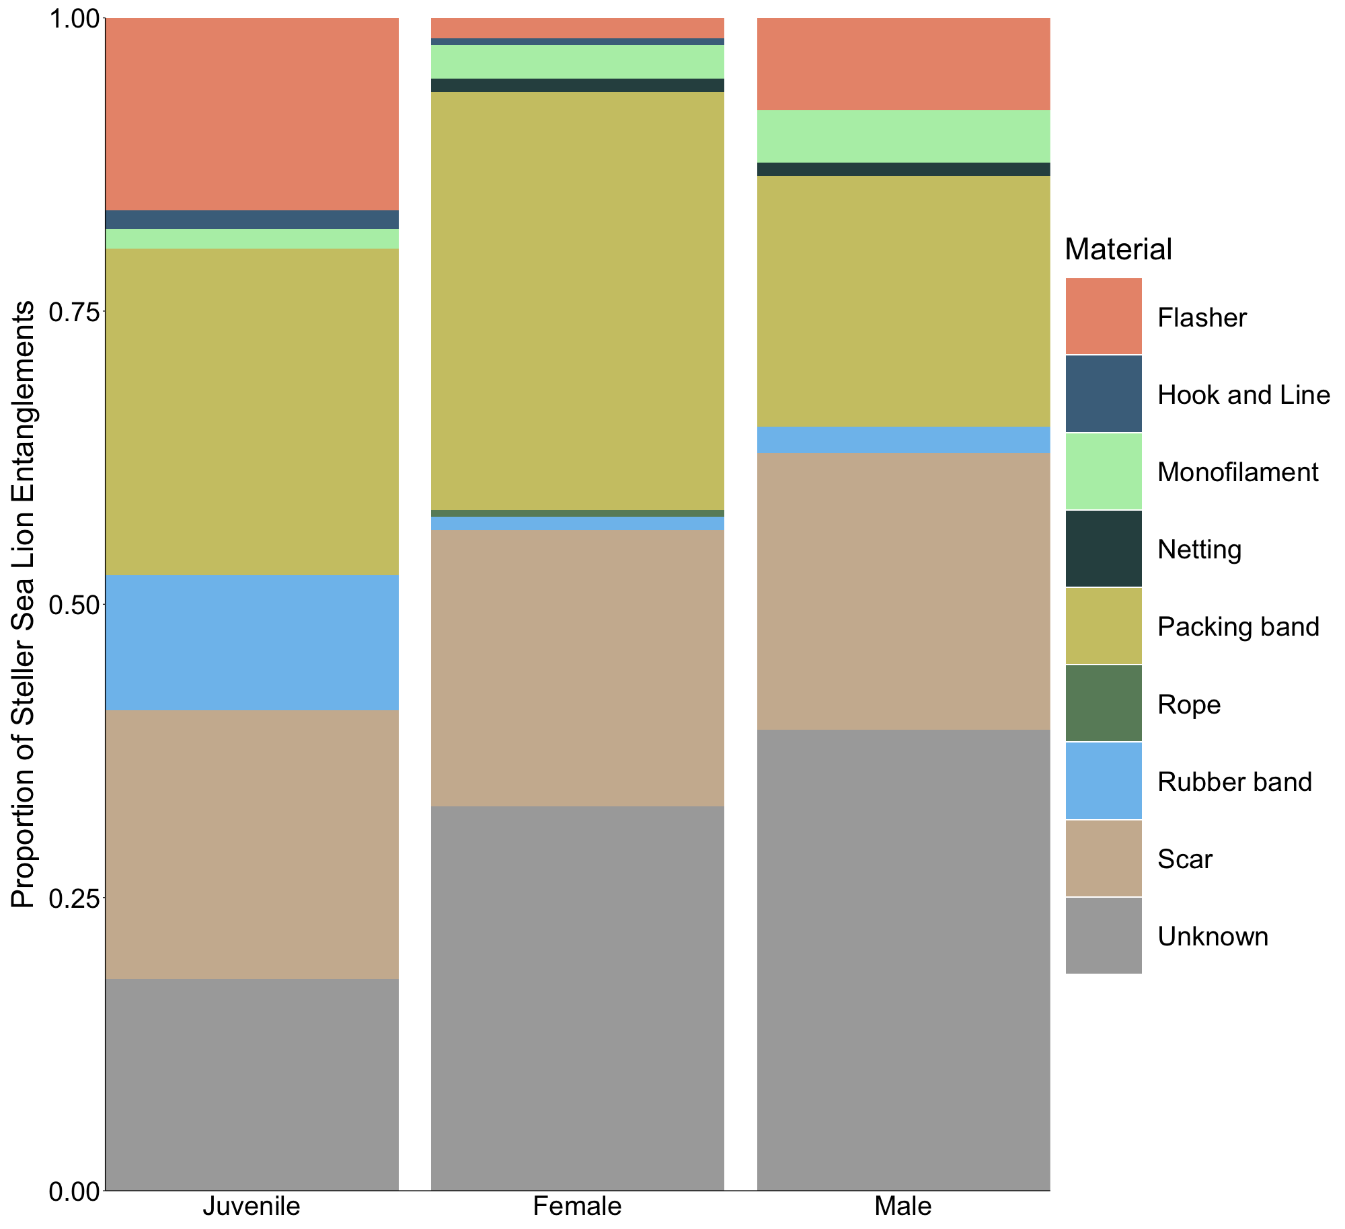
n = 324

Slide 25
Ej Counts trend
SUMMARY OUTPUT
Regression Statistics
Multiple R | 0.915078
R Square | 0.837367
Adjusted R Square | 0.814134
Standard Error | 13.70499
Observations | 9
ANOVA
 | df | SS | MS | F | Significance F
Regression | 1 | 6769.601 | 6769.601 | 36.04174 | 0.00054
Residual | 7 | 1314.787 | 187.8267
Total | 8 | 8084.388
 | Coefficients | Standard Error | t Stat | P-value | Lower 95% | Upper 95% | Lower 95.0% | Upper 95.0%
Intercept | -21233 | 3563.386 | -5.95866 | 0.000565 | -29659.1 | -12806.9 | -29659.1 | -12806.9
Year | 10.62199 | 1.769306 | 6.003477 | 0.00054 | 6.438246 | 14.80574 | 6.438246 | 14.80574

Slide 26
Packing band annual ents-surveys
 | Year | (ER x mat prop) | (mat ent/all ent) | (band ents/effort) | OCNMS wo open/surveys
Year | 1
(ER x mat prop) | -0.27691251 | 1
(mat ent/all ent) | -0.33416292 | 0.71227355 | 1
(band ents/effort) | -0.0685691 | 0.76586115 | 0.88145347 | 1
OCNMS wo open/surveys | -0.62719824 | 0.33539851 | 0.60660978 | 0.57854594 | 1
Best correlation between packing band occurrences in OCNMS surveys corrected for effort by dividing by the number of surveys conducted each year (packing bands encountered per survey [conducted in the Olympic Coast region]) and the proportion of entanglements included in the material analysis that were caused by packing bands (PB ents/all ents [photo quality >1]) r = 0.61, weak correlation.

Slide 27
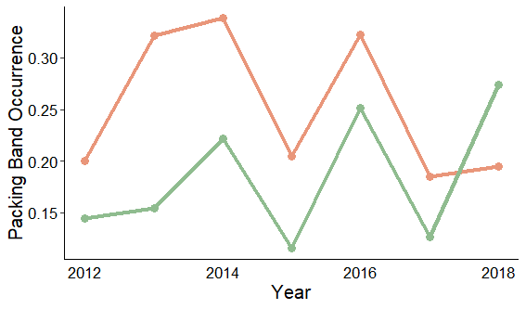
Packing bands
2012-2017
 | (ER x mat prop) | (band ents/effort) | (mat ent/all ent) | OCNMS (wo open/surveys) | OCNMS (total/surveys)
(ER x mat prop) | 1
(band ents/effort) | 0.78352459 | 1
(mat ent/all ent) | 0.65877947 | 0.88237193 | 1
OCNMS (wo open/surveys) | 0.33476094 | 0.57367572 | 0.61552948 | 1
OCNMS (total/surveys) | 0.26477124 | 0.72289799 | 0.80724556 | 0.38628956 | 1
2012-2018
 | (ER x mat prop) | (band ents/effort) | (mat ent/all ent) | OCNMS (wo open/surveys) | OCNMS (total/surveys)
(ER x mat prop) | 1
(band ents/effort) | 0.76586115 | 1
(mat ent/all ent) | 0.71227355 | 0.88145347 | 1
OCNMS (wo open/surveys) | 0.33539851 | 0.57854594 | 0.60660978 | 1
OCNMS (total/surveys) | -0.14569068 | 0.4186555 | 0.36568347 | 0.24038973 | 1

Slide 28
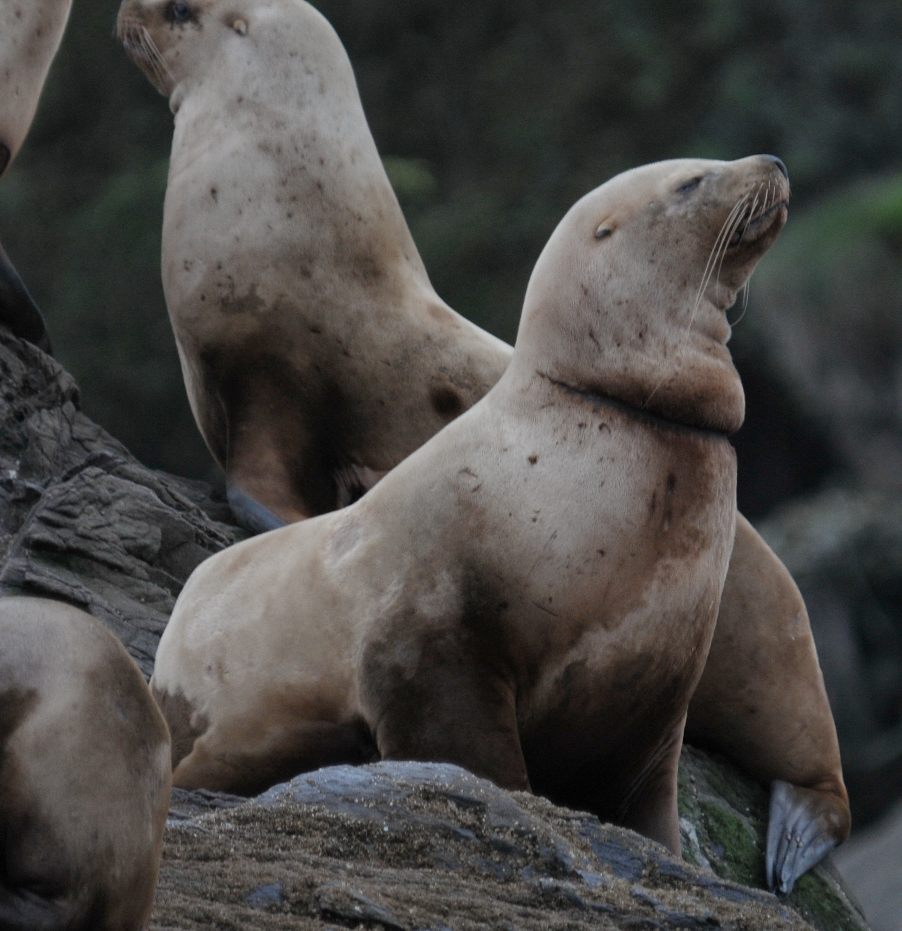
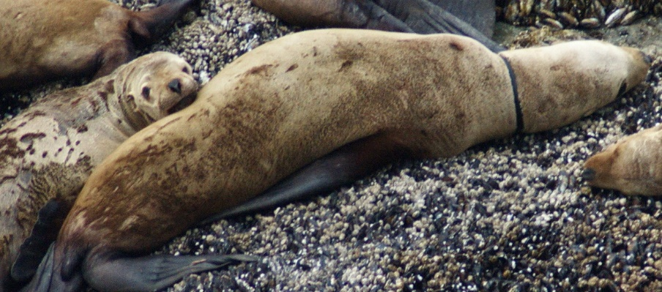
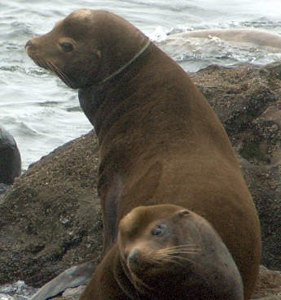
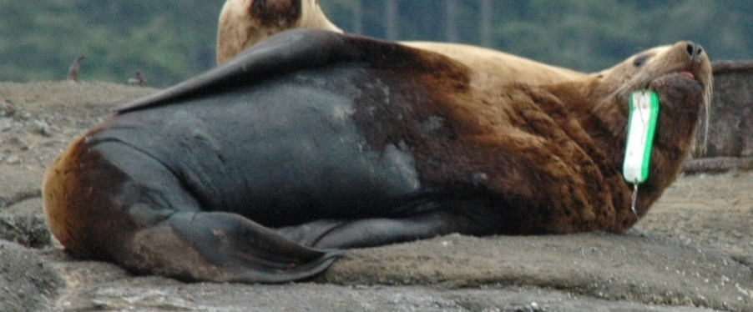
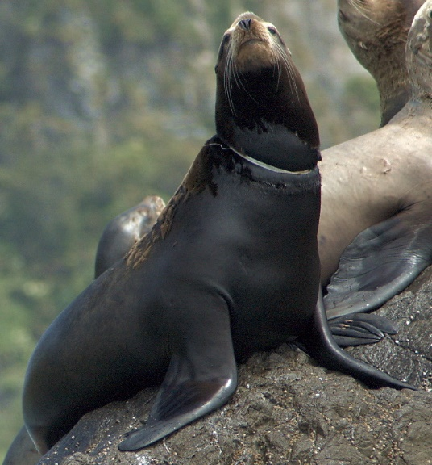
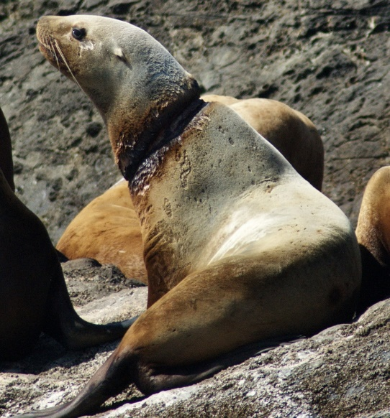
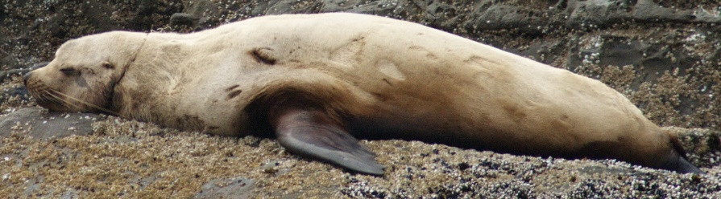
b
a
c
g
f
e
d

